Slide 1
BRITISH AIRWAYS
FLIGHT REVIEWS ANALYSIS

Slide 2
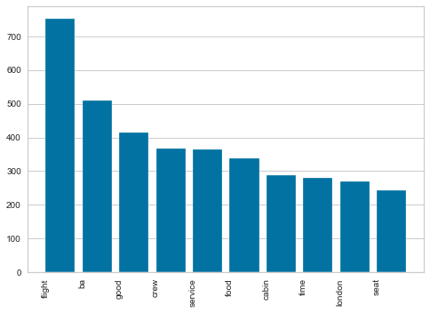
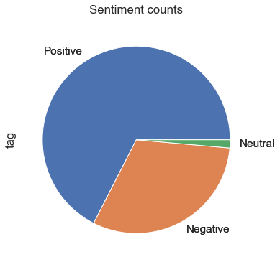
SKYTRAX Results
According to the results of the analysis, it was found that “crew”, “service”, “food” and “seat” were some of the main passenger concerns.
Out of all the reviews analysed, 670 were positive, 310 were negative and 20 were neutral.
67%
2%
31%

